Slide 1

Exception Code Table
watech.wa.gov
August 2015

Slide 2


Exception Codes
Why they were created
The Exception Code Table was created to:
  Allow payments for one-time non-reportable payments
  Replaced the Pseudo number of V0D0 and V0D1. These numbers can still be seen in Enterprise Reporting.
Office of Financial Management, Statewide Accounting will be responsible for maintaining the Exception Code Table.
watech.wa.gov
August 2015

Slide 3
Exception Codes
Available Exception Codes
The current Exception Codes are:
  01 – Revenue/Reissues Refunds
    Payments for Non-Expenditure Related Refunds
  02 – Emergency Payroll & Related 3rd Party Payments
    Payments made outside HRMS such as reissue, emergency, military, & 3rd Party Payments.
  03 – Non-Employee Reimbursement
    Non-employee travel reimbursement, supplies or training reimbursement.
watech.wa.gov
August 2015

Slide 4
Exception Codes
Available Exception Codes
  The current Exception Codes are (continued):
  04 – One-Time Direct Grant Payments to Individuals
    One Time direct Grant Payments such as Natural Disaster victims
  05 – Other Payees with NO Taxpayer ID
    Other Payees, No TIN, Not covered by 01-04
  06 – Reissue Federally – Funded Payroll SOL (DSHS)
    Reissue Federally-Funded Payroll SOL warrant cancellations by DSHS.
watech.wa.gov
August 2015

Slide 5
Exception Codes
Code Structure & Table location
The Exception Code is a two (2) character field (numeric only)
Agencies can view the codes on a screen within the Tables (TM)
  TM.1.4 – Payment Exception Code Table
watech.wa.gov
August 2015

Slide 6
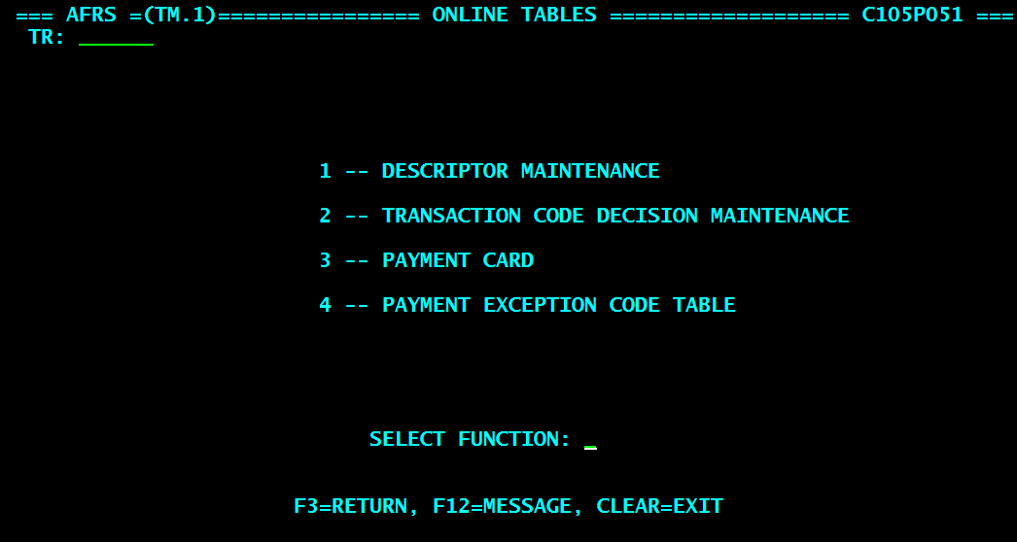
Exception Codes
watech.wa.gov
August 2015

Slide 7
Exception Codes
Navigating to the Exception Code
Enter ‘4’ into the “Select Function” field and then hit enter. This will bring up the Payment Exception Code Table.
watech.wa.gov
August 2015

Slide 8
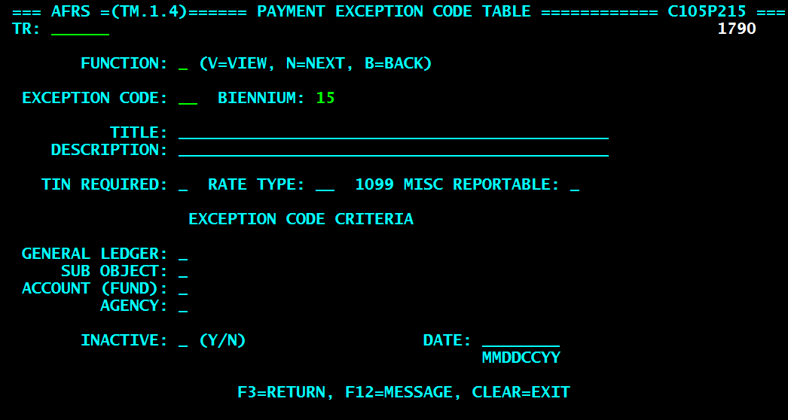
Exception Codes
watech.wa.gov
August 2015

Slide 9
Exception Codes
Navigating to the Exception Code
Enter an ‘N’ into the “Function” field and then hit enter. This will bring up the first exception code.
watech.wa.gov
August 2015

Slide 10
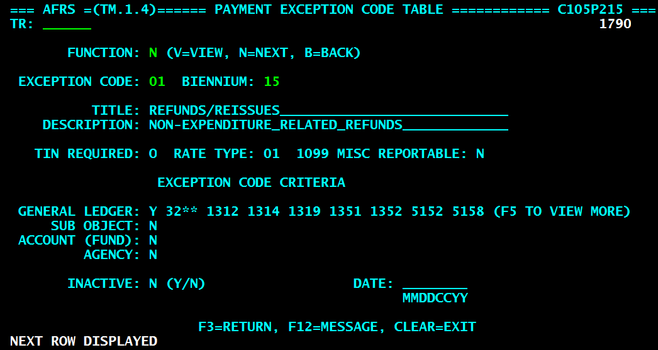
Exception Codes
watech.wa.gov
August 2015

Slide 11
Exception Codes
Field Detail Descriptions
  Function = Allows the user to view (v) a specific exception code, see the next (n) exception code, or go back (b) to the previous exception code
  Exception Code = This will be a two digit field from 01-99.
  Biennium = Current will be the default.
watech.wa.gov
August 2015

Slide 12
Exception Codes
Field Detail Descriptions
  Title = Name of the Exception Code
  Description = Short explanation of the purpose of the exception code.
  TIN Required = There are three potential codes available for this field
      Y = TIN is required
      N = TIN is not required
      O = TIN is optional
watech.wa.gov
August 2015

Slide 13
Exception Codes
Field Detail Descriptions
  Rate Type = This tells the user what type of tax rate is applicable to these payments. The types currently available are:
      01 – 0% tax
      02 – 28% tax
    Note: The functionality associated with this field currently does not exist.
  1099 Misc Reportable = This tells the system when a transaction is or is not 1099-MISC reportable.
      Y (yes) = Transaction will be assigned appropriate IRS Box
      N (no) = Transaction will be assigned an IRS Box of ‘0’
watech.wa.gov
August 2015

Slide 14
Exception Codes
Field Detail Descriptions
  Exception Code Criteria = Allows the exception code to be refined to only allow specific types of transaction by using one of the following:
      General Ledger
      Sub Object
      Account (FUND)
      Agency
  Inactive = OFM Statewide Consultants have the ability to inactivate any of the exception codes by simply changing the ‘N’ (no) to a ‘Y’ (yes). They then must enter a date of when it will be inactive.
watech.wa.gov
August 2015

Slide 15
Exception Codes
Field Detail Descriptions
Exception Code Criteria will show a predetermined number of codes, if there is more codes for one of the exception code criteria an ‘F’ key will be displayed that you will use to see all the associated criteria.
Hit the ‘F’ key and you will be taken to a new screen to see the full listing of either General Ledgers, Subobjects, Accounts (Fund), or Agencies.
watech.wa.gov
August 2015

Slide 16
Exception Codes
watech.wa.gov
August 2015

Slide 17
Exception Codes
Additional Data functions
The following are the potential ‘F’ keys that would be available:
    F5 = General Ledgers
    F6 = Subobjects
    F7 = Accounts (Fund)
    F8 = Agencies.
watech.wa.gov
August 2015

Slide 18
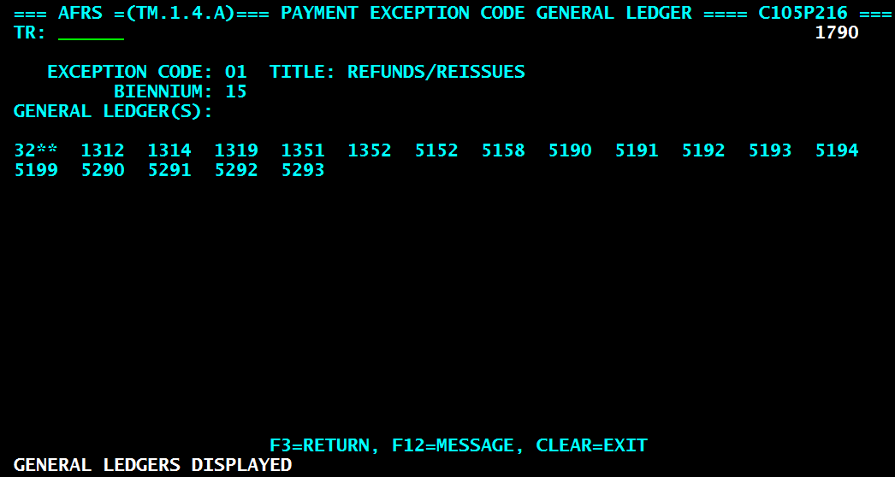
Exception Codes
watech.wa.gov
August 2015

Slide 19
Exception Codes
Payment Processes
Payments can be made using the Exception Code through the following:
  Online entry
    IN.1.1, Expanded General Accounting Transaction Input
    Expanded General Accounting Transaction Input for Error & Browse feature on the IN.3
  Toolbox entry
    Located between Contract & Vendor Number on Toolbox Template
  Batch system Interface
    950 Layout-Position 801, 2 bytes, numeric only
watech.wa.gov
August 2015

Slide 20
Exception Codes
AFRS INPUT SCREENS
watech.wa.gov
August 2015

Slide 21
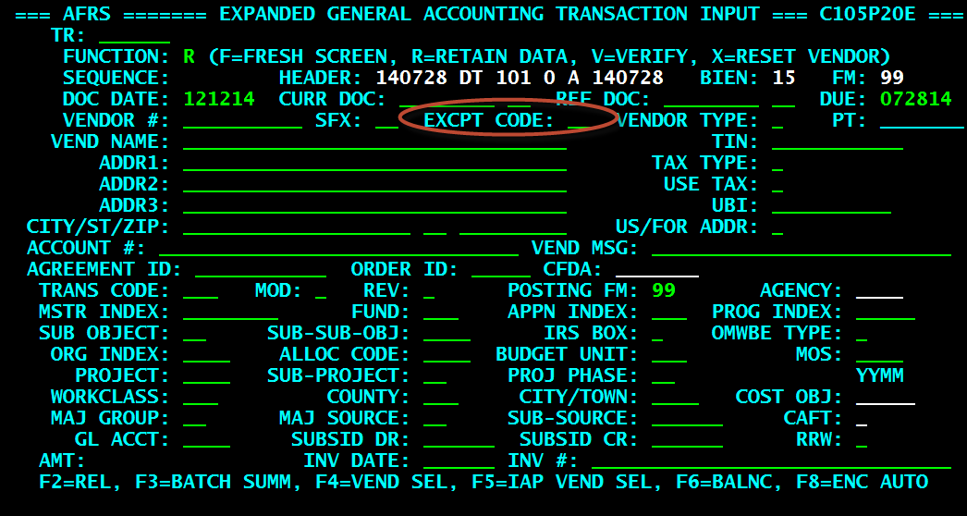
Exception Codes
Input Screen
watech.wa.gov
August 2015

Slide 22
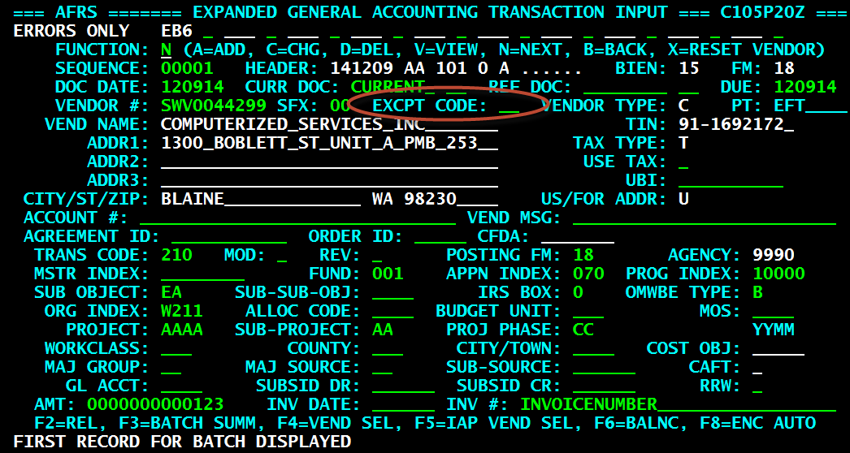
Exception Codes
Input Error Correction Screen
watech.wa.gov
August 2015

Slide 23
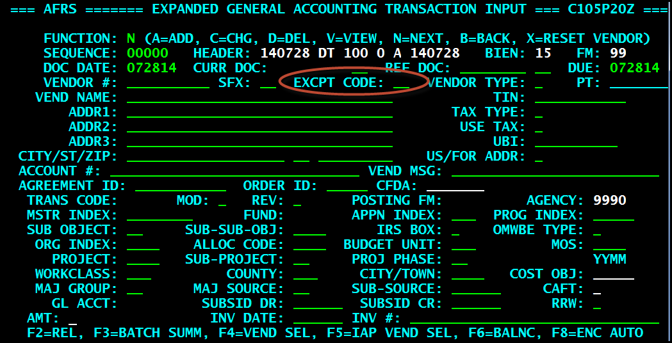
Exception Codes
Input Screen
watech.wa.gov
August 2015

Slide 24

Questions/Comments?
Solutions Center
Phone: 360-407-9100
Email: solutionscenter@watech.wa.gov
watech.wa.gov
August 2015

