Slide 1
Environmental Scan
State Human Resources Division
Office of Financial Management
June 2013

Slide 2
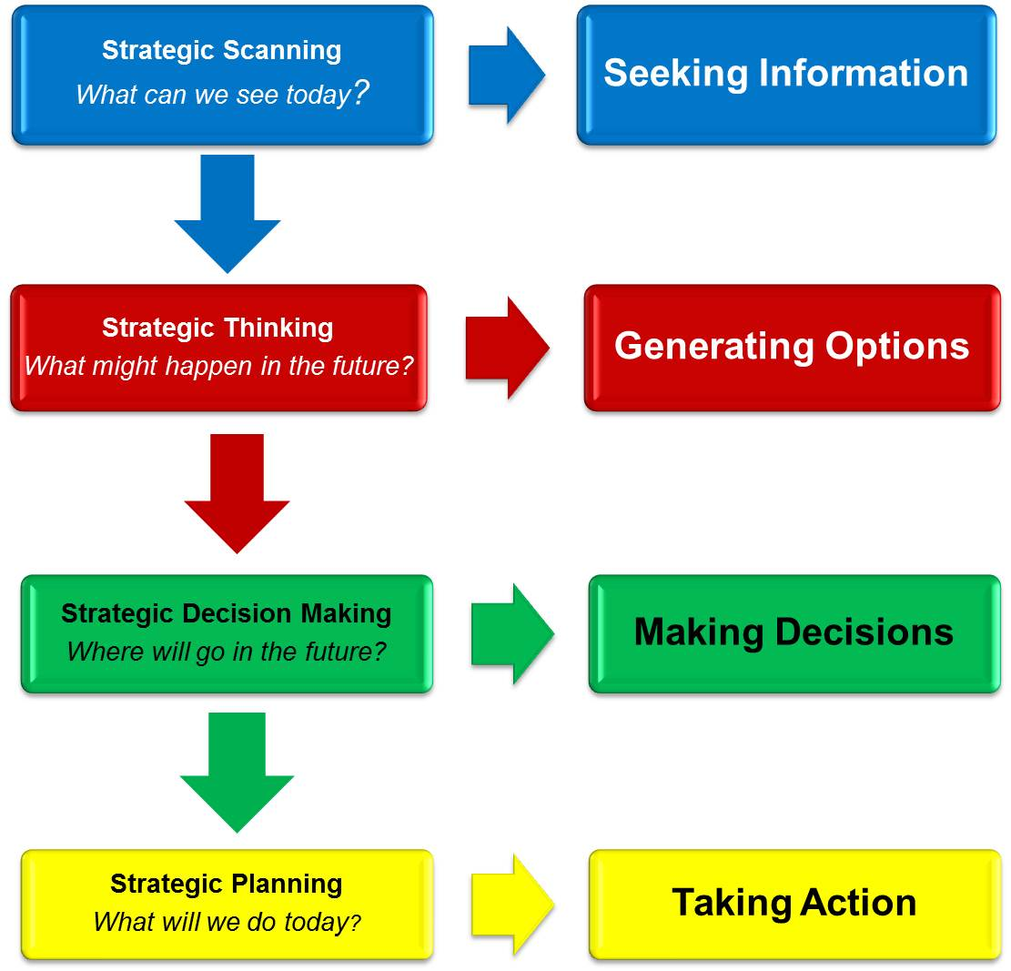
What is environmental scanning?
“Environmental scanning is the art of systematically exploring and interpreting the external environment to better understand the nature of trends and drivers of change and their likely future impact on your organization.”
- Conway, 2009
Graphic provided by Marie Conway, Thinking Futures. 2013.
Quotation from Marie Conway. (2009). Environmental Scanning – what it is and how to do it”, slides 20-21. Accessed at Slideshare.com
Notes:
Point is not to predict the future, but to think about possibilities and how we would respond
Broad look, not in depth
Not advocating for issues or trends – not normative, but informative

Slide 3
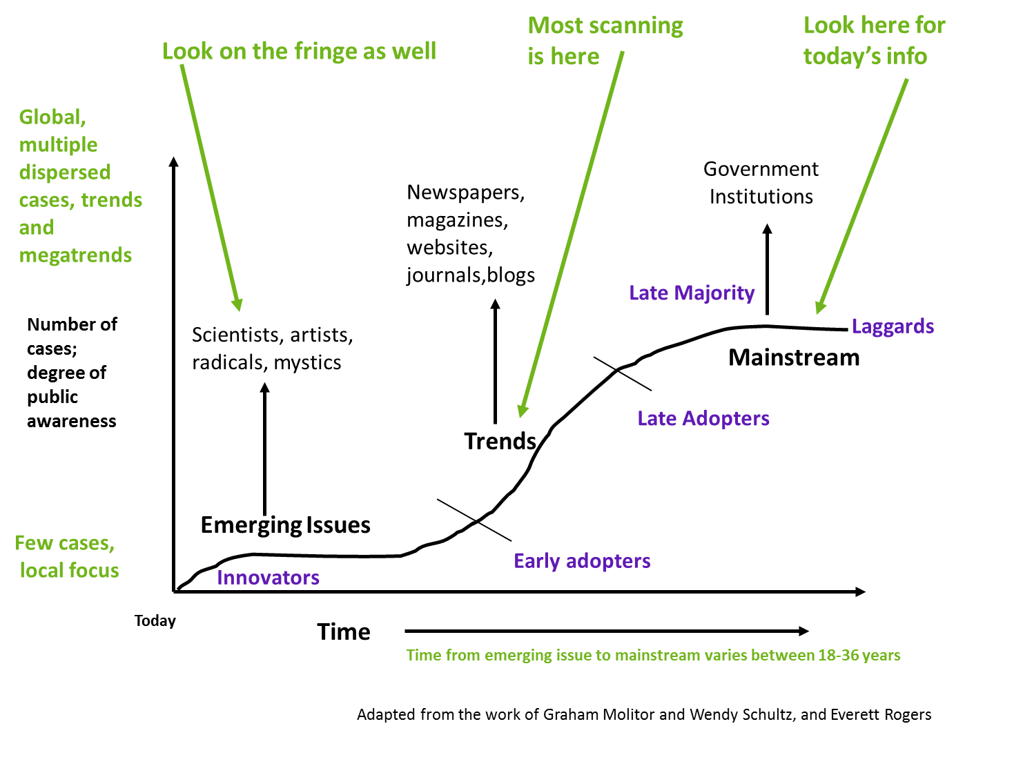
Emerging, Trending, or Wild Card?
What to look for, according to Conway (2009):
Use emerging issues to challenge long-term assumptions and for “what if” questions.
What are the drivers of trends? Is there a connection between trends?
What are potential wild cards? [Wild cards are less likely to occur, but would be highly disruptive if they did occur.]
However…
Not all emerging issues become trends; not all trends go mainstream
Pace varies – some issues & trends move quickly, others slowly
Graphic provided by Marie Conway, Thinking Futures. 2013.
Paraphrase from Marie Conway. (2009). Environmental Scanning – what it is and how to do it”. Accessed at Slideshare.com

Slide 4
Environmental Landscape
Technology
Global
Industry
Human Resources in Washington State Government
Political
Information
Demographic
Individual Empowerment
Multi-polar political world
Environment
Social
Economics
Big data
Automation & AI
Collaborative Governance
Flexible workplace
Labor
Cultural
Flexible workforce
Public sector pensions
Predictive analytics
Slow economic growth
Anti-union laws
Demographic Changes
Self-service & on-demand
Privacy & data security
Crowd-sourced solutions
Automation of high-skilled labor
Aging & more Hispanic workforce
Climate Change
Social networks
Public sector replacement hiring
Network performance & learning
Disaster readiness & recovery
Hourly & temp workers
Notes:
Industry – Public sector & human resources

Slide 5
Focus Area Categories
Business Management & Strategy – includes strategic role of HR; HR business management skills; strategic planning process; evaluating internal/external environment; and the legislative and regulatory environment
Workforce Planning and Employment – includes employee rights, privacy, and consumer protection legislation; organizational staffing requirements; job analysis and documentation; recruitment, flexible staffing, selection and retention
Human Resource Development – includes organizational development initiatives; adult learning and motivation; training and development; talent and performance management
Compensation and Benefits – includes compensation structure and systems; benefit programs (govt. mandated, deferred comp plans, health care and other non-statutory benefits); compensation and benefits legislation; evaluation of comp and benefits programs
Employee and Labor Relations – includes employee and labor relations legislation; union organizing and collective bargaining; unfair labor practices; discipline and complaint resolution
Risk Management – includes organizational risk; workplace safety, health, security and privacy; risk management legislation
Adapted from Society for Human Resource Management learning modules for the PHR/SPHR certifications. From http://www.shrm.org/Education/educationalproducts/learning/Pages/modules.aspx

Slide 6
External Environmental Scan Results
Focus Area | Emerging Issues | Trends | Wild Cards
Business & Management Strategy | Big data for prediction Encouraging innovation Collaborative / network governance Enterprise content management systems | Open- and crowdsourcing for solutions On demand & self-service Lean process improvement
Workforce Planning & Employment | Virtual workforce High performance talent pools Slow hiring for government workforce; mostly replacements Anti-discrimination protection for unemployed Focus on hiring people with disabilities | Aging and increasingly Hispanic workforce Part-time and temporary employees for flexibility Social media recruitment & branding STEM pipeline | Automation / AI for knowledge – based jobs
HR Development | Employee engagement focus for performance and productivity Network performance | Technology and social learning and development Lifelong learning as expectation
Compensation & Benefits | Retirement readiness of workforce | Modest increase in salaries for most U.S. workers Health plan premium increases Sustainability of public pensions
Employee & Labor Relations | Non-union employee groups Uncertainty regarding recent NLRB decisions | Anti-union efforts Increase in FLSA lawsuits Employer vs. employee rights re: social media | Decreased union presence in WA
Risk Management | Protecting HR & HR data from natural disaster risks Resilient, adaptable organizations Use of big data to predict and prevent Quantified self for self improvement – wellness efforts | Workplace wellness program incentives Data security & privacy protections Strengthening accountability & public confidence through “e-government”
Notes:
One page overview looking at key emerging issues, trends, potential wildcards, grouped according to SHRM categories
More details on following slides

Slide 7
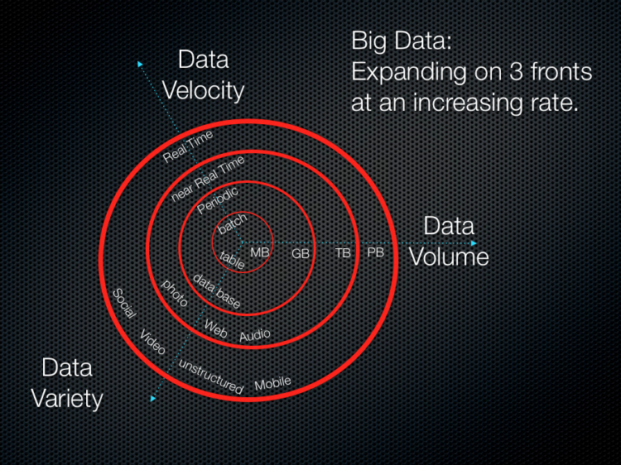
Business Management Strategy
Key Trends:
  Open-sourced and crowd-sourced solutions
  Self-service and on-demand access to data, information, and other decision-making tools
  Lean process improvement
  Enterprise content management to increase efficiency
  Emerging Issues:
    Use of “big data” to anticipate events for more effective strategic planning
    Encouraging innovation for creative problem solving
    Collaborative / network governance
From: Soubra, Diya (2012), “The Three Vs that Define Big Data”. Accessed at http://www.datasciencecentral.com/forum/topics/the-3vs-that-define-big-data
Key drivers: Big data; social networks; individual empowerment; multipolar political world
Notes:
Continuation of efforts to increase accountability and innovation with limited resources through open- and crowd-sourcing – wikis, social networks, e-government /government 2.0 efforts
Self-service and on-demand – people expect what they want when they want it how they want it – multi-platform, customer-focused, empower individuals
Lean process improvement – Gov. Inslee continued emphasis on lean to improve efficiency and increase employee engagement
Enterprise content management – workflow, imaging, document storage, etc – to reduce amount of “paper pushing” and increase efficiency
Collaboration & network governance – increasing interconnected, shared responsibility, integrating efforts when possible

Slide 8

Workforce Planning & Employment
Key Trends
  Demographic changes expected include an aging workforce; increased numbers of Hispanics in the workforce; increased demand for post-secondary degrees; and increased demand for apprenticeships
  Continued demand for labor flexibility through use of part-time and temporary workers; continued efforts to weaken unions through anti-union laws
  Slow hiring in public sector; most hiring will be replacement hires
  Use of social media for recruitment & branding
  Building STEM pipeline
Emerging Issues
  Use of high-performance talent pools to fill key positions
  Virtual workforce (Bring your own device, flex space options, flex schedules, virtual workspaces & communities)
  Anti-discrimination protections for the unemployed
  Focus on hiring people with disabilities
Wild Card
  Artificial Intelligence & automation replaces knowledge workers like doctors, lawyers, HR and IT
Are you hiring?
Key drivers: Demographic changes, flexible workforce, slow economic recovery, & social networks
Notes:
Demographic and hiring projections from BLS data & projections
Social media buzz continues – increasing calls for being able to demonstrate ROI
While STEM shortage is debated, need for employees with STEM skills is widely accepted (STEM skills such as critical thinking, problem solving, data analysis, are applicable to many professions)
Despite Yahoo’s recent rollback of telework, trend continues in direction of virtual workforce
DOL & National Governor’s Association – focus on hiring people with disabilities
Unlikely that “robots will take our jobs” but, as technological capabilities for AI and automation increase, there will be a strong incentive to use these technologies to replace at least some of the work done by knowledge workers

Slide 9
Human Resource Development
Key Trends
  Online and social learning – expectation for multiplatform, on demand, & high-quality
  Expectation for lifelong learning – multiple career changes, need for adaptability
Emerging Issue
  Focus on employee engagement as key driver of performance & productivity
  Recognition that performance is not only individual, also “network”
The American Society for Training & Development’s 2013 Learning & Development Technology Report reflects that most organizations are increasingly interested in technology based training options and plan to increase their investment in e-learning.
From: Pace, Anne. (2013). Learning Technology Trends in 2013. Accessed at http://www.astd.org/Publications/Magazines/TD/TD-Archive/2013/02/Intelligence-Learning-Technology-Trends-in-2013
Key drivers: Individual empowerment; social networks; and automation & artificial intelligence
Notes:
Online & social learning – social networks, webinars, online courses, games as tools for learning
Some questions/interest in measuring the success of these learning tools as compared to more traditional, in-person learning methods
Lifelong learning – expectation for continuous learning in workforce to stay agile and innovate
Mounting evidence that employee engagement is crucial to organizational performance and productivity
Research by CLC indicating that we also need to measure network performance, not just individual, in increasingly collaborative, matrixed workplaces

Slide 10
Compensation & Benefits
Key Trends
  Modest increase in compensation for most U.S. workers
  Health plan premiums continue to increase, but more slowly
  Continued concerns about the sustainability of public pensions
Emerging Issues
  Concern about employee readiness to retire; most workers have insufficient savings
Key drivers: Slow economic recovery, individual empowerment
Notes:
Modest salary increase for most US workers according to BLS
Pew Stateline says more than half of states will increase state worker salaries slightly, but in most cases this is just restoring pay cuts that were taken away during recession.
According to SHRM, the cost curve for health care is bending downward (due to recession, changes in health care delivery, structural changes), but employee premiums are still increasing
Employers looking at various strategies, including wellness programs and incentives, consumer-driven designs, plan designs
According to recent polls, most workers not prepared for retirement. Employers focusing on increasing worker readiness.

Slide 11

Employee & Labor Relations
Key Trends
  Anti-union legislation
  Increase in FLSA lawsuits
  Social media policies versus employees rights
Emerging Issues
  Non-union employee groups
  Uncertainty over recent NLRB decisions due to recess appointment decision
Wild Card
  Decreased union presence in Washington state
Key drivers: Flexible workforce; individual empowerment; social networks
Notes:
Proponents of anti-union legislation plan to continue pushing agenda
FLSA lawsuits – more than tripled over last decade according to the HR Specialist primarily due to misclassifying workers as exempt, failing to pay workers working “off the clock”, not paying for unapproved overtime. Concern that this trend will continue.
Social media gray area – still very murky as to what employees can post, what content employers own and can restrict, discipline for – still being worked out
Emergence of non-union employee advocacy groups; don’t have same rights, mechanisms, or funding streams that unions have, but have seen some success with service workers, home care workers, etc. Partnering with unions in some cases.
NLRB decisions – not clear what will happen to decisions made by Obama Administration recess appointees
Wild card - decreased public sector unions in WA; seems unlikely at least in near future, but what if?

Slide 12
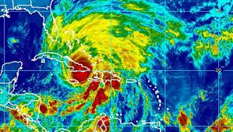
Risk Management
Key drivers: Individual empowerment; social networks; big data; and climate change
NOAA/National Hurricane Center
Key Trends
  Workplace wellness programs - incentives & ROI
  Concerns about data security & privacy protections
  Accountability and public confidence through increased transparency
Emerging Issues
  Use of big data to predict and prevent
  “Quantified self” data in wellness programs
  Protecting HR and HR data from natural disaster risks
  Resilient, adaptable organizations
Notes:
Wellness programs – more employers using incentives to encourage healthy behavior; need for standard, defensible metrics for measuring ROI
Data security & protection – proliferation of multiple devices, virtual workspaces, big data, social networks, and concerns about how this data is safeguarded
Desire to harness predictive power of data to manage risks
Quantified self movement – has potential tie-ins to wellness efforts, change personal behavior through use of data
HR & HR data – natural disaster risk increasing due to climate change; how to prepare – links to enterprise content management, use of social networks and virtual workspaces, etc

Slide 13

Next Steps
How would we respond to these challenges?
What actions can we take today to better prepare ourselves for the future?
What possibilities haven’t we considered? How likely are these possibilities and what would we do?
Internal scan – What resources do we already have? What other resources will we need?
Strategic plan – How do our goals, objectives, and actions today prepare us for possible tomorrows?

Slide 14
Sources
American Bar Association
American Society for Training and Development
Brookings Institute
Corporate Leadership Council
Deloitte
Families and Work Institute
Federal Times
Governing Magazine
Government Technology
Govloop
HR Specialist
Human Resource Executive Online
IBM Center for the Business of Government
National Association of State Personnel Executives
National Center for Education Statistics
National Conference of State Legislatures
National Governors Association
National Labor Relations Board
Pew Research Center
Pew Stateline
Public Administration (PA) Times
Public CIO
Slate
Society for Human Resource Management
The Center for Public Education
The Futurist
The New York Times
The Week
Time Magazine
TLNT: The Business of HR
USA Today
U.S. Bureau of Labor Statistics
U.S. Department of Labor
U.S. National Intelligence Council
Washington Post
Washington State Economic and Revenue Forecast Council
Washington State Office of the Chief Information Officer
World at Work

