Slide 1
Census Enumerator Training
Notes:
Welcome to the Office of Financial Management census mapping training.
As mentioned in the Administrator training section, maps are very important for a successful census Maps help make sense and order of the census area. They are used to keep track of progress, define the census area, help eliminate confusion, define supervisor and enumerator areas, and much more.
The mapping and examples in this section, will be referenced in relation to an annexation census. The mapping techniques for an annexation census and a city census are exactly the same. A city census map usually involves larger areas and larger size maps that are hard to show effectively in a presentation. So, examples are shown from an annexation census.
All maps in this training are real maps. Outlined annexation areas may not be real and are just for demonstration purposes. Basic map terminology and definitions have been presented in the Administrator Training and are not repeated here.
If you have questions, you can always contact OFM Forecasting and Research. Contact information is found at the end of this presentation.
During this training, our agency name is abbreviated OFM.

Slide 2
Note: This training may contain visual elements including data forms and geographical maps. To meet accessibility standards, visual elements are tagged and/or described in readable text. If you have any difficulty or need assistance accessing any of the information contained in this training, please contact the Office of Financial Management, Forecasting and Research Division, by phone at 360-902-0599, or by email at pop.annexations@ofm.wa.gov
Notes:
Note: This training may contain visual elements including data forms and geographical maps. To meet accessibility standards, visual elements are tagged and/or described in readable text. If you have any difficulty or need assistance accessing any of the information contained in this training, please contact the Office of Financial Management, Forecasting and Research Division, by phone at 360-902-0599, or by email at pop.annexations@ofm.wa.gov

Slide 3
Table of Contents
Confidentiality, safety, and job requirements
Housing unit definitions and types
Canvassing procedures
Enumeration procedures
How to fill out the field enumeration sheet
Frequently asked questions
Notes:
There are six sections in this training.
Confidentiality, safety, and job requirements
Housing unit definitions and types
Canvassing procedures
Enumeration procedures
How to fill out the field enumeration sheet
Frequently asked questions by residents
All sections are important. Please listen to each section. You can repeat any section later if you would like to refresh your memory.

Slide 4
Confidentiality, Safety, and
Job Requirements
Notes:
The first section concerns confidentiality, safety, and job requirements.

Slide 5
Must Keep Information Confidential
The Census information that you collect is confidential and protected by law. You can only discuss census results and questions with your supervisor. No one else.
Copied below is RCW 42.56.615 that guarantees confidentiality.
RCW 42.56.615
Enumeration data used by the office of financial management for population estimates.
Actual enumeration data collected under RCW 35.13.260, 35A.14.700, 36.13.030, and chapter 43.62 RCW shall be used and retained only by the office of financial management and only for the purposes of RCW 35.13.260, 35A.14.700, 36.13.030, and chapter 43.62 RCW. The enumeration data collected is confidential, is exempt from public inspection and copying under this chapter, and in accordance with RCW 43.41.435, must be destroyed after it is used.
[ 2014 c 14 § 1.]
Notes:
All the information you collect is confidential and is protected by law. Tell no one, except your supervisor, about anything you learn. If someone insists on looking at your paperwork, lock the paperwork in your car and call your supervisor. No one is allowed to see the sheets except you and your supervisor. This includes law enforcement, elected officials, city government staff, coworkers and regular citizens. Copied below is RCW 42.56.615 that guarantees confidentiality.
If someone wants to pursue disclosure, he/she has to file a public records request with the Office of Financial Management in Olympia. RCW 42.56.615 protects the confidentiality of the data collected. Any request for census data will be denied. There is no exception.

Slide 6
Safety
Your safety is very important
Work in pairs when needed, especially in the evening and in areas with potential problems.
Do not enter anyone’s home.
You could be attacked
You could be accused of assault/theft
This would also lengthen the interview
Bring a cell phone for emergencies.
Wear bright colored clothing.
Use a personal safety light when appropriate.
Find out if you are provided with injury insurance.
Notes:
Your safety is of paramount importance.
We recommend you work in teams of two when needed. This is especially true for evening work and in areas with potential problems. Discuss with your supervisor if you run into any problems or situations .
Never enter anyone’s home. Do all your interviewing at the door. The potential problems include:
You could be attacked.
You could be accused of attack or burglary.
Going inside the home also lengthens the interview.
Bring a cell phone with you so that you can contact someone in an emergency. They are also handy in talking with your supervisor.
Wear bright colored clothing.
Use a personal safety light when appropriate.
OFM does not provide insurance coverage. Before you begin, find out who has responsibility for providing insurance.

Slide 7
Enumerator Requirements
You must know your responsibilities as an enumerator:
Read the manual ahead of time and refer to it as needed.
Know how to read maps.
Know your assigned area and stay in it.
Know how to count housing units and residents.
Know how to complete the Field Enumeration Sheet.
Must follow census procedures exactly and efficiently.
Must be able to work evenings and weekends.
Be meticulous, careful, and courteous.
Must be able to keep all information confidential.
If you can not adhere to these requirements, this job is not for you.
Notes:
To do this job, you must understand the requirements for a census enumerator. By the end of the training be sure that you are up for the job.
For this job, you will need to:
Read the manual ahead of time and refer to it as needed
Know how to read maps
Know your assigned area and stay in it
Know how to count housing units and residents
Know how to complete the Field Enumeration Sheet.
You must be willing to:
Work evening and weekend work
Meticulous, careful, and courteous
Keep all information confidential
If you can not adhere to these requirements, this job is not for you.

Slide 8
Housing Unit Definitions
Notes:
The first census definition you need to know is that of a housing unit. This includes building structure type. Structure type means the number of living units in a specific building and what type of building.
Structure types you may encounter can have anywhere from one to over a hundred units in one building. (You will only categorize up to 5-or-more.) Structure type includes manufactured/mobile home and unusual structures. There are even living structures that are not housing units.
All this will be covered in more detail in this section.

Slide 9
What Is A Housing Unit?
A housing unit is one or more rooms intended for permanent occupancy with direct access from outside the building or through a common hall.
A building is not a housing unit, no matter what it looks like, if
It is dilapidated/ unlivable, and no one lives in there.
It is a new construction with no exterior in place (not weather tight).
It is used entirely for storage or commercial purposes.
Notes:
A housing unit is one or more rooms intended for permanent occupancy with direct access from outside the building or through a common hall.
A building is not a housing unit, no matter what it looks like, if:
It is dilapidated/ unlivable, and no one lives in there.
It is a new construction with no exterior in place (not weather tight).
It is used entirely for storage or commercial purposes.

Slide 10
What Is An Occupied/Vacant Housing Unit?
An occupied housing unit is one with one or more residents usually living and sleeping there.
A vacant housing unit is one where a resident person does not live in the unit as a primary home.
There are two additional types of vacant housing unit situations:
Housing for temporary stay. Examples are: a corporate rental, vacation home, regular hotel/motel, etc. The people in them usually have a different place to call home.
New construction in progress. If it is weather tight, count it. The interior does not have to be complete..
Notes:
An occupied housing unit has one or more resident persons usually living and sleeping there. (Resident definitions are covered later.)
A vacant housing unit has no resident person living in the unit as a primary home.
Also vacant are:
Housing units for temporary stay. Examples are: a corporate rental, vacation home, hotel/motels for transients, etc. The people in them usually have a different place to call home.
New construction in progress. If it is weather tight, it is counted as a vacant unit. The interior does not have to be finished.

Slide 11
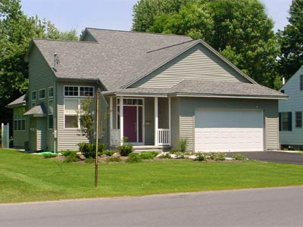
Structure Type: Single Detached Dwelling (1-Unit)
The basic features for single family housing are:
The structure is built to house one family, or household.
It is detached from any other residential building.
This category includes modular and prefabricated homes.
Notes:
You are required to collect housing type information. The basic features for single family housing are:
The structure is built to house one family or household.
It is detached from any other residential building; this includes no car ports attached to two structures
This category includes modular and prefabricated homes

Slide 12
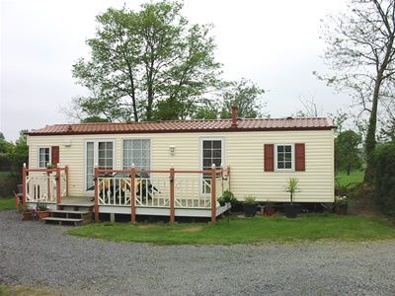
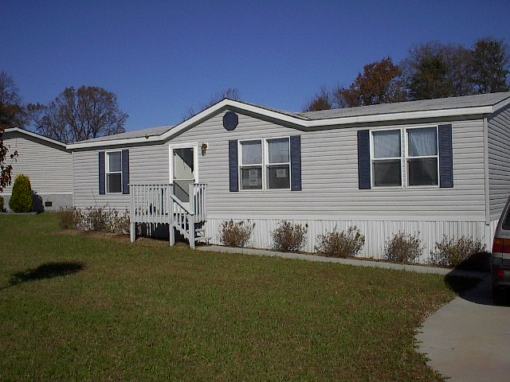
Structure Type: Manufactured Home (MH)
A mobile home, also referred to as manufactured home, are movable housing units intended for permanent occupancy on private lots or in parks. The special features for such units are: they are not built on site and can be moved. They may or may not have a regular foundation.
Notes:
A mobile home, also referred to as manufactured home, are movable housing units intended for permanent occupancy on private lots or in parks. The special features for such units are: they are not built on site and can be moved. They may or may not have a regular foundation.

Slide 13
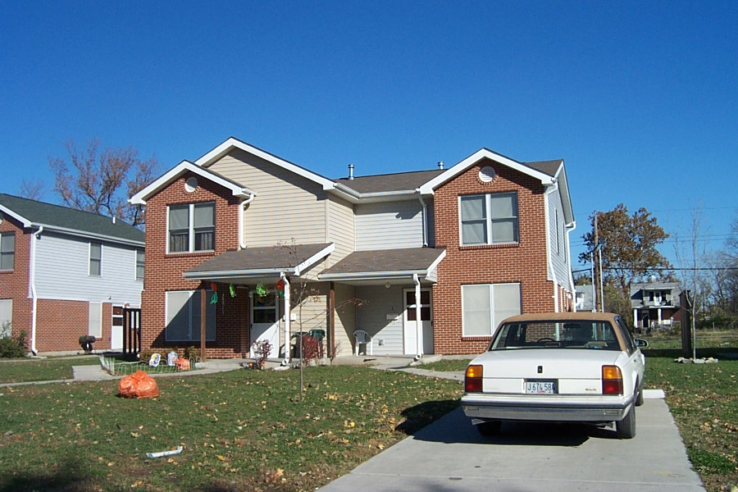
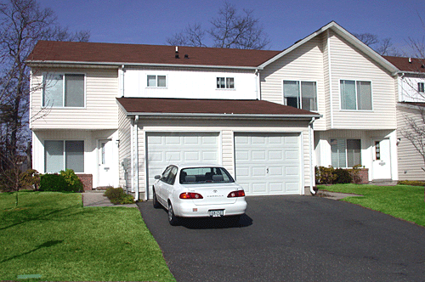
Structure Type: Duplex (2 Units)
A two-unit structure, often called a duplex, is one structure with two housing units in it. The units can be side by side or top and bottom. If two separate units are side by side and joined by a carport, they are considered as a duplex. You need to fill out two field enumeration sheets, one for each unit.
Units side by side
Units top and bottom
Notes:
A two-unit structure, often called a duplex, is one structure with two housing units in it. The units can be side by side or top and bottom. If two separate units are side by side and joined by a carport, they are considered as a duplex. You need to fill out two field enumeration sheets, one for each unit.

Slide 14
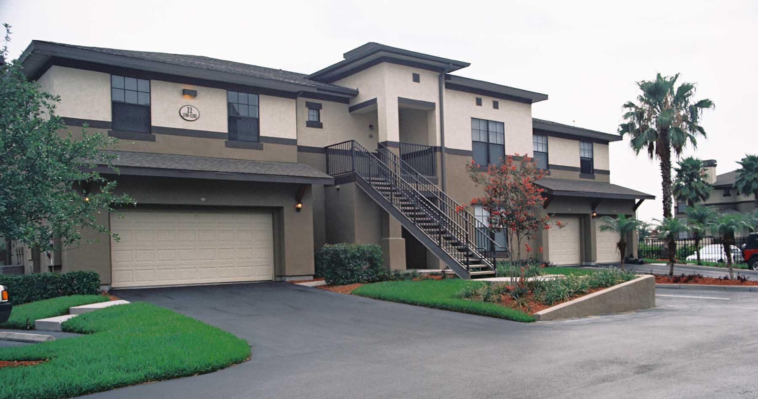
Structure Type: Triplex/Quadraplex (3-Unit or 4-Unit)
Notes:
This picture shows a combination of side-to-side and up-down 3-unit construction. Sometimes you will see a 4-unit structure with both side to side and up –down units.

Slide 15
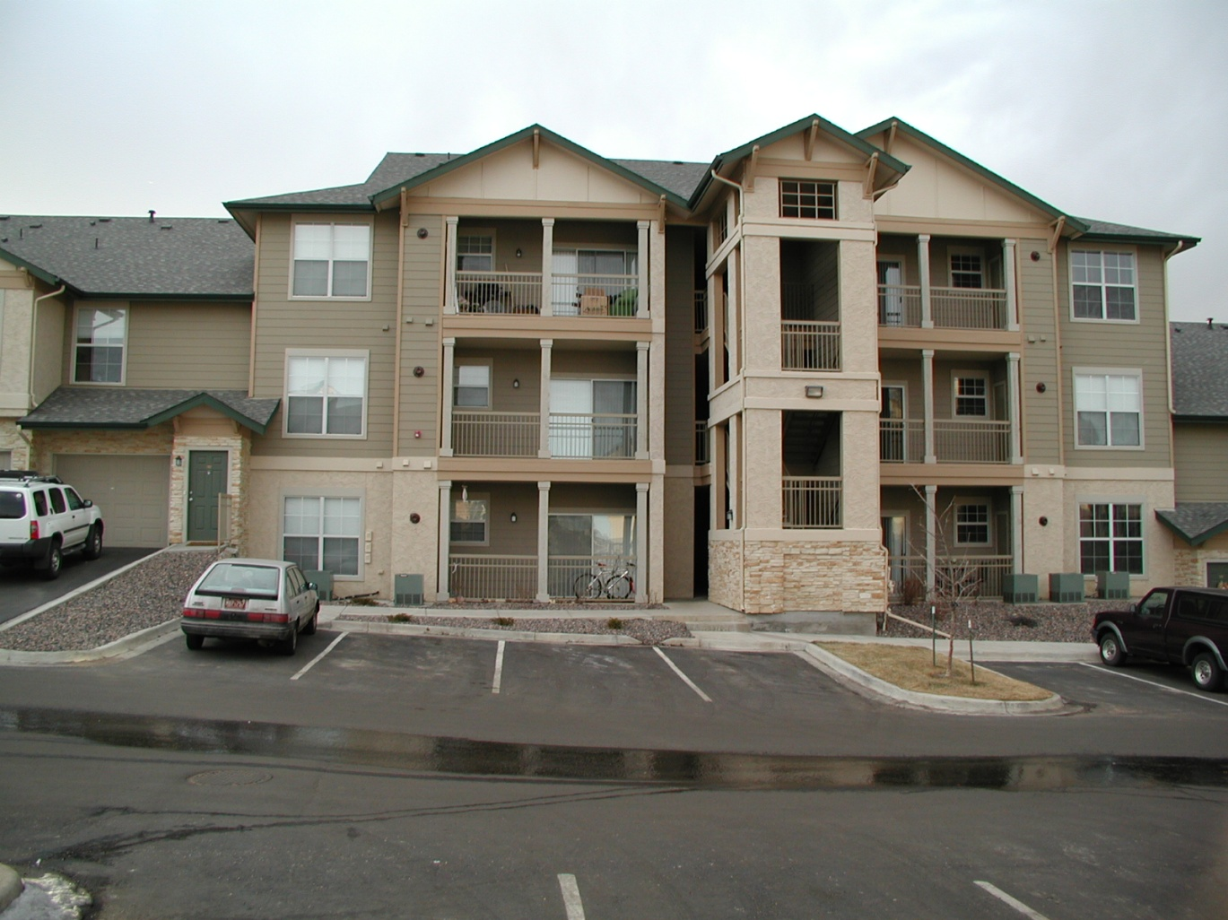
Structure Type: Five-or-More Unit Structure (5+ units)
Notes:
This is a common structure with 5 or more units in it. Access to the units, in this case, is from the outside for each unit rather than a common hallway. Some structures may have 100 or more units.

Slide 16
Structure Type: Accessory Dwelling Unit (ADU)
Accessory dwelling units (ADUs) are additional living quarters on single-family lots that are independent of the primary dwelling unit. The separate living spaces are equipped with kitchen and bathroom facilities, and can be either attached or detached from the main residence.
If you encounter an ADU, count the main structure as a single family home. Count the ADU as a separate 5+ unit structure on a new field enumeration sheet.
Make notes on your field enumeration sheet that this is an ADU.
Notes:
Accessory dwelling units (ADUs) — also referred to as accessory apartments, second units, or mother-in-law apartments — are additional living quarters on single-family lots that are independent of the primary dwelling unit. The separate living spaces are equipped with kitchen and bathroom facilities, and can be either attached or detached from the main residence. Occupancy rates and the number of people per unit tend to be very similar to 5+ structures.
If you encounter an ADU, count the main structure as a single family home. Count the ADU as a separate 5+ unit structure on a new field enumeration sheet.
Make notes on your field enumeration sheet that this is an ADU.

Slide 17
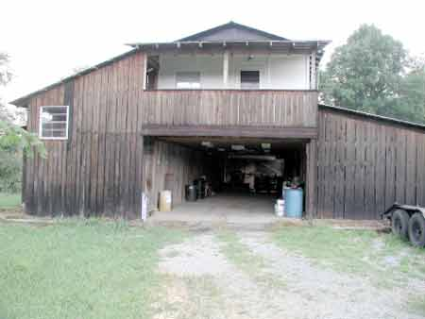
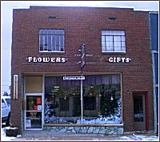
Looking for Concealed Living Units
Always look for concealed units. Hints for hidden units are:
Extra mailboxes
Multiple electricity meters
RVs in the yard
Live-in garage
Always ask about potential units. Sometimes a respondent will report everyone on the property as if in a single residence.
Always ask a business about apartments in the building.
Notes:
When going from house to house, always look for concealed units. Extra mailboxes, multiple electricity meters, and RVs in the yard are all hints that there may be extra living units near the main house. Another situation is that there may be a live-in unit above the garage. Or a mother-in-law unit (or ADU) in the basement.

Slide 18
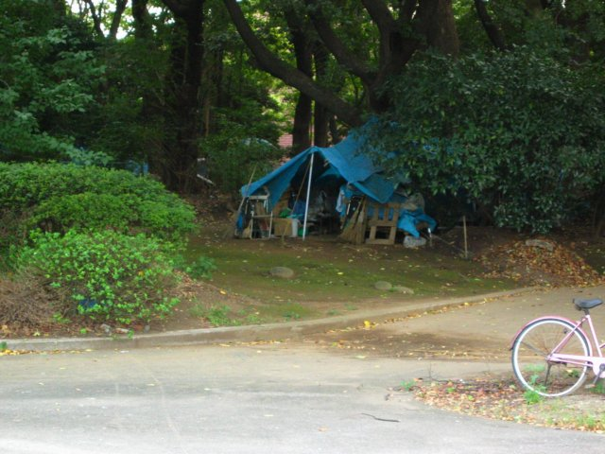
Structure Type: Specials
Living quarters not intended for permanent occupancy.
Only count them when occupied – special units can not be vacant.
Examples include travel trailers, RVs, boats, tents, boxcars etc.
Notes:
Some structures are not originally intended to be permanent living quarters. But, people choose to live in them and not have another living place. Such can be a motor home, travel trailer, boats or boxcars and tents, etc. You count them as housing units only when some one is living in them. There are no vacant special housing units.

Slide 19
Hotels, Motels, YMCA, YWCA
If people who live in these places meet residency rules, count the units they live in as specials.
A unit is not counted as a housing unit unless someone is living in it.
Manager or staff live permanently onsite:
If live in a room, count the room as a special housing unit.
If live in an apartment, count as a regular housing unit, 5+ structure type.
Exception:
If 75% or more of the rooms are filled with permanent residents, then it is essentially an apartment in nature. Count the resident people and their rooms. Classify their units as 5+. Count all other units as vacant.
Notes:
Contact your supervisor to see if a prior contact has been made with the establishment. Then seek assistance from the manager in order to determine long term occupants.
If people living here are residents, count the units they live in as specials.
Do not count the other units. They are not housing units.
You may run into situation where:
A Manager or staff live permanently onsite.
If they live in a room, count the room as a special housing unit.
If they live in an apartment, count as a 5+ structure type.
There is an exception to the above rules.
If 75% or more of the rooms are filled with permanent residents, then it is essentially an apartment in nature. Count the people who are resident. Label their structure type as a 5+ structure. Count all other units as vacant.

Slide 20
Group Quarters (GQ)
Group quarters are living arrangements for groups of 10 or more unrelated persons living together. They reflect living arrangements other than ordinary household life. They should have been contacted and know you are coming.
Group quarters are not housing units. They are facilities.
Examples are prisons, jails, nursing homes, boarding houses, military barracks, student dorms, mental hospitals, monasteries, homeless shelters.
If there are fewer than 10 persons, count them as living in a housing unit.
The exception: live-in staff and their living quarters.
If there are staff members who live onsite and have no other usual residence, their living quarters should be counted as housing units.
.
Notes:
Within your area, you may encounter some special situations. Group quarters is one of them. GQ are living arrangements for groups of 10 or more unrelated resident persons living together. They should have been contacted and know you are coming.
GQ are not housing units. They are facilities.
Typical examples include prisons, jails, nursing homes, boarding houses, military barracks, student dorms, mental hospitals, monasteries. If the facility has less than 10 residents, count them as a housing unit.
There is one exception in the GQ situation. Sometimes staff members live onsite. They have no other usual residence. Their living quarters are counted separately as housing units.

Slide 21
Living Situations that Are Not Group Quarters
The following are not GQ facilities and should be counted as regular 5+ housing units
University controlled family housing.
Senior housing where residents do not have 24 hour/7 days a week access to medical care. This includes assisted living apartment for the elderly, and congregate care.
If less than 10 people reside in a single family home, count as regular single family home (example: adult family home).
Do not count the housing or population in short-term care facilities.
Physical rehabilitation, drug/alcohol rehabilitation, hospitals and juvenile detention centers. The residents of these facilities do not meet OFM’s residency rules.
Notes:
Sometimes determining whether a building is a GQ facility or not is not straight forward. If you run into four situations listed below, you should pause and think about the GQ criteria before enumeration:
Dormitories owned by a college or university are considered GQ facilities, but a university controlled family housing complex is not. They should be counted as multi-unit housing.
There is a lot of senior housing that has been built throughout the state. The key to distinguishing a GQ from a housing unit structure is whether the residents have 24 hour/7 days a week access to medical care or not. Usually an assisted living structure does not provide such medical care or an onsite nurse, and therefore they should be counted as multi-unit housing.
Last but not least, short-term care facilities should never be counted as housing. Physical rehabilitation, drug/alcohol rehabilitation, hospitals and juvenile detention centers should be ignored. Since people who are in these units do not meet the OFM resident rule of living there for 6 months or more, we do not count those facilities as GQ.
When in doubt, contact your supervisor. If the supervisor is uncertain about the GQ definitions, he/she should contact OFM for guidance.

Slide 22
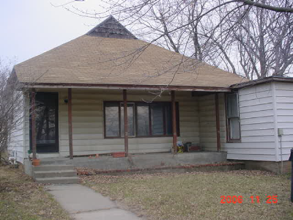
Vacant Housing
Sometimes it is obvious that a unit is vacant when the house is completely empty with no curtains or furniture.
Notes:
A housing unit is considered vacant if it has no resident occupants. Sometimes it is obvious that a unit is vacant when the house is completely empty with no curtains or furniture.
However, you may also run into housing units that are used as storage, time share (persons live elsewhere permanently). You can not determine if the housing is vacant or not until you conduct an interview. Once you have verified that the housing is used for temporary lodging, then mark the unit as vacant.

Slide 23
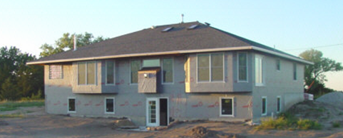
Vacant New Construction (VNC)
For newly built structures, you should count it as a vacant new construction unit if it is weather tight. That is, if the structure has its roof, all outside walls/doors/windows in place, and floor.
Notes:
For newly built and weather tight structures, you should count it as a vacant new construction unit. Usually it has reached the stage where the entire exterior shell is in place. That is, the structure has its roof, and all outside walls, doors, floors and windows are all in place.

Slide 24
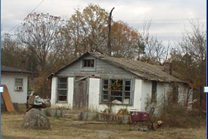
Not Counted If Unoccupied and Dilapidated/Unlivable
Notes:
A dilapidated housing is usually obvious. Do not count it as housing unit unless someone is actually living in it.

Slide 25
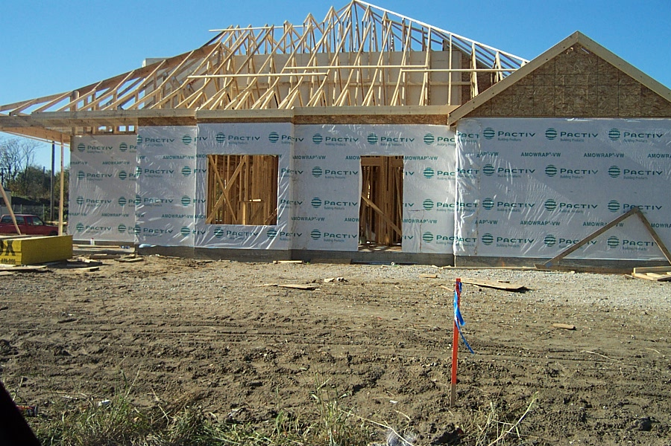
New Construction But Not a Housing Unit
If the new construction has no exterior in place, do not count it. It is not weathertight. Do not fill out a field enumeration sheet either.
Notes:
This is new construction without an exterior in place. There are no windows, doors and/or roof. It is obviously not weathertight and should not be counted. Do not complete a field enumeration sheet either. The city will report it later to OFM when it is completed.

Slide 26
Canvassing Procedures
Notes:
So far, you have learned how to categorize a housing unit. This section will train you how to count residents and block techniques. There two concepts in this section: canvassing technique and enumeration procedure. We will talk about canvassing first.

Slide 27
Canvassing
Canvassing means to go through an area in a systematic manner so that the entire area is examined and no housing units are missed.
A good, complete canvass is essential to the accuracy of a census.
Enumerators are responsible for the complete canvass of their assigned area.
Notes:
Counting houses in a systematic manner is known as canvassing.
It means that you go block by block till you cover an assigned area. The entire area should be examined and not miss any housing units.
A good, complete canvass is essential to the accuracy of a census.
Enumerators are responsible for the complete canvass of their assigned area.

Slide 28
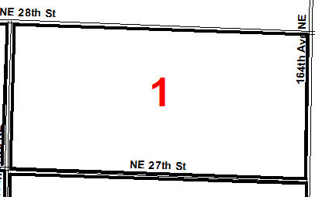
Canvassing Regular Enclosed Block
You will canvass block by block. The most common type is a regular enclosed block. It is rectangular in shape and all sides are roads.
To canvass, find the closest housing unit to the northeast corner. Then enumerate in a clockwise direction. You should be able to stop at the same place as you started without crossing a street.
If you do encounter a street and it does not go all the way to the opposite side of the block (for example, a cul de sac), canvass up one side and then down the other side, and continue around the block.
Notes:
You will canvass block by block. The most common type is a regular enclosed block. It is rectangular in shape and all sides are roads.
For a regular enclosed block, go to the NE corner and start enumerating to your right. There may not be a housing unit there, but you go until you arrive at one.
Then continue in the same direction until you arrive where you started.
You should be able to walk so that you do not have to cross a street. If you do encounter a street and it does not go all the way to the opposite side of the block (for example, a cul de sac), canvass up one side and then down the other side, and continue around the block

Slide 29
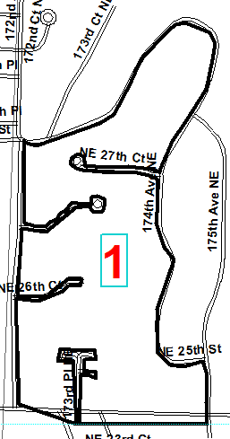
Canvassing Irregular Enclosed Block
For an irregular enclosed block, all sides are roads, but one or more sides are not straight. Follow the rules as for a regular enclosed block. Your starting point may not be as obvious. But, you should be able to arrive back at the starting point without crossing a road.
X
Notes:
For an irregular enclosed block, all sides are roads, but one or more sides are not straight. Follow the rules for a regular enclosed block. Your starting point may not be as obvious. Just choose a point as close as possible to the NE corner and start enumerating. Again, you will arrive back at the beginning point without crossing a street.

Slide 30
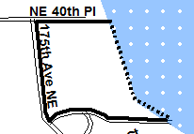
Canvassing Unenclosed Block
An unenclosed block has at least one boundary that is not a street. A dashed line on the map indicates a border that is not a road.
Mentally, find the northeast corner and go to the right. Start at the first housing unit encountered. You will not be able to stop at the same place you started.
X
Stop
Start X
Notes:
An unenclosed block has at least one boundary which is not a street. The dashed line on your map indicates a border that is not a road.
You need to find a place to start that will still enable you to go to the right around the block, but, don’t have to stop to re-position yourself and re-start again. Sometimes this is not possible.
If you follow the required clockwise path on this block, you start enumerating at the southeast corner and finish at the northeast corner. You do not try to go along the lakefront. Just enumerate to your right until the last housing unit is done. You will not be able to stop at the same place you started.

Slide 31
Amend the Map If Necessary
Sometimes you may need to amend the map.
If the street does go through the middle of the block to the other side, amend your map so you have two blocks. Draw a line to show two blocks.
Sometimes an alley way is a major throughway and/or the only way to access a housing unit. Label the alley on your map as a block boundary.
In both cases you now have two blocks. Give the newly created block the same number as the original one and add an “A” to it.
Report the map changes to your supervisor.
Notes:
Sometimes you may need to amend the map.
If the street does go through the middle of the block to the other side, amend your map so you have two blocks. Draw a line to show two blocks.
Sometimes an alley way is a major throughway and/or the only way to access a housing unit. Label the alley on your map as a block boundary.
In both cases you now have two blocks. Give the newly created block the same number as the original one and add an “A” to it.
Report the map changes to your supervisor.

Slide 32
Empty Block
If there are no residential housing units in the block, it is an empty block
If commercial buildings are found, contact the office and ask about possible on-site living quarters.
Fill out a field enumeration sheet for the empty block and label as vacant.
Notes:
If there are no residential housing units in the block, it is an empty block.
If commercial buildings are found, contact the office and ask about possible on-site living quarters.
Fill out a enumeration sheet for the empty block.

Slide 33
Canvassing: Special Situation
Check with your supervisor before enumerating the following:
Gated communities
Large multi-unit structures
Mobile home/manufactured home parks
Hotel/motel
Marinas
Your supervisor may have already established contact with the manager and may have a plan for enumeration.
Notes:
Check with your supervisor or administrator before enumerating the following:
Gated communities
Large multi-unit structures
Mobile home parks
Motel/hotel
Marinas
Your supervisor may have already established contact with the manager and may have a plan for enumeration.

Slide 34
Canvassing: Special Situation (continued)
Approach the manager or appropriate person for apartment buildings, mobile home parks, hotel/motels:
Explain to the hotel/motel reason why you are there and ask for a list of occupied rooms.
For apartment buildings:
Ask about corporate housing and count them only when occupants live there 6 months or more.
Make arrangements to get in and enumerate from door-to-door, following your map.
Confirm vacancies.
While enumerating mobile home parks, please remember:
An empty spot is not a vacant mobile home.
Keep a count of empty spots as OFM is tracking capacity.
Special units (such as RV’s) are counted only if people live in them permanently. There are no vacant specials.
In all cases, record the contact person and his/her phone number.
You cannot give the apartment/hotel manager any information about residents.
Notes:
Before enumerating gated communities or apartment complexes, contact the manager to:
Explain to the hotel/motel reason why you are there and ask for a list of occupied rooms. For a hotel/motel you will need a list of occupied units.
Do not count corporate housing as occupied unless the occupants live there 6 months of more
Make arrangements to get in and enumerate from door-to-door, following your map. For an apartment complex with multiple building, you may follow the building sequence numbers.
For mobile home parks, please remember:
An empty spot is not a vacant mobile home.
Keep a count of empty spots as OFM is tracking capacity.
Special units (such as RV’s) are counted only if people live in them permanently. There are no vacant specials.
In all cases, record the contact person and his/her phone number.
Remember: You cannot give the apartment/hotel manager any information about residents.

Slide 35
Canvassing: Homeless
Homeless persons do not have a usual place of residence.
May have a temporary bed in a homeless shelter.
If homeless or transients are found
Inquire if currently living in a shelter. If staying in a shelter, they are counted where the shelter is located. Get name of shelter.
Inquire if they are currently living in a homeless encampment. They are counted at the encampment. Talk with your supervisor. Enlist the help of local agencies that provide services to homeless people.
If a homeless person is not staying in a shelter and sleeping where night overtakes them, count them as group quarter population.
Notes:
Homeless persons do not have a usual place of residence
They may have a temporary bed in a homeless shelter
If homeless or transients are found
Inquire if currently living in a shelter. If staying in a shelter, they are counted where the shelter is located. Get name of shelter.
Inquire if they are currently living in a homeless encampment. They are counted at the encampment. Talk with your supervisor. Enlist the help of local agencies that provide services to homeless people. Do not just wander in and start asking for names.
If not staying in a shelter and sleeping where night overtakes them, count them as GQ population where you find them.

Slide 36
Canvassing-Summary
Canvass blocks in the order specified by your supervisor, and stay in your assigned area.
Start at northeast corner of the block if possible and travel in a clockwise direction.
If there is a conflict with starting in the NE corner and going to the right, going to the right takes precedence
If you need to deviate from the rules for safety reasons- like one way street- be consistent and document your reasons on enumeration map.
For multi-unit structure, be consistent and methodical. Always finish a building before continuing on to the next structure.
Do not count empty spaces in a manufactured home park as a vacant manufactured home.
Keep track of empty spaces in a park.
Notes:
Canvass blocks in he order specified by your supervisor, and stay in your assigned area.
Start at northeast corner of the block if possible and travel in a clockwise direction.
If there is a conflict with starting in the NE corner and going to the right, going to the right takes precedence
If you need to deviate from the rules for safety reasons- like one way street- be consistent and document your reasons on enumeration map.
For multi-unit structure, be consistent and methodical. Always finish a building before continuing on to the next structure.
Do not count empty spaces in a manufactured home park as a vacant manufactured home.
Keep track of empty spaces in a park.

Slide 37
Enumeration Procedures
Know who to count based on resident rules
Know how to residents using OFM Census Sheet A – Field Enumeration Sheet
Know how to interview residents.
Notes:
Now that you have learned how to canvass an area, it is time to learn how to enumerate the residents living in the area. You will learn how to count people based upon the residency rules. Also, you will learn how to use the OFM Census Sheet A – Field Enumeration and how to conduct an interview.

Slide 38
Know Who to Count and How to Count Them
Who to count:
Resident- A person who usually lives and sleeps in the housing unit or facility for the majority of the year (6 months or more) or has no other usual place of residence. Do not count people who are visiting, or stay here temporarily with a usual residence elsewhere, such as college students home for summer vacation.
How to count them
List all the names of residents who live in the household, starting with an adult on the field enumeration sheet
Screen the information you just recorded using the questions at the bottom of the page. The questions are designed to make sure that short-term stay persons are not included and no eligible persons are missed
Notes:
As an enumerator, you need to know who to count:
Resident- A person who usually lives and sleeps in the housing unit or facility for the majority of the year (6 months or more) or has no other usual place of residence. Do not count people who are visiting, or staying here temporarily with a usual residence elsewhere, such as college students home for summer vacation.
Then, you must know how to count them:
List all the names of residents who live in the household, starting with an adult on the field enumeration sheet.
Screen the information you just recorded using the questions at bottom of page. The questions are designed to make sure that short-term stay persons are not included and no eligible persons are missed.

Slide 39
Residence Rules
Person: | Resident of:
Lives in the housing unit, temporarily away. (e.g., vacation, hospital, traveling job) | This housing unit
Lives in house on weekends, works and has a room or apartment elsewhere | The other place. DO NOT LIST
Persons in the Armed Forces who live in this household when they are not deployed | This housing unit.
Persons in the Armed Forces who live in military quarters on base | The military quarters on base. DO NOT LIST
Persons in the Armed Forces who are stationed overseas. | Their overseas location. DO NOT LIST
College students who do not live in this household during school year | Place where he/she lives while attending school. DO NOT LIST
Persons who divide their time equally between homes | Where they are at the time of the census
Persons who divide their time unequally between homes | Where they spend the majority of the year
Notes:
Whether or not to count someone is dependent upon their living situation. We are now going to review the most common situations. This table can also be found in the Enumerator’s Manual. The situation: You have received the names for people living in the housing unit you are at. Now you are checking residency and the respondent indicates one of the following situations:
Person lives in the housing unit, temporarily away. (e.g., vacation, hospital, traveling job: The person is a resident of this housing unit.
Person lives in house on weekends, works and has a room or apartment elsewhere: The person is a resident of the other place. DO NOT LIST IN THIS HOUSING UNIT.
Persons who are in the Armed Forces who live in this household when not deployed. The person is a resident of this housing unit
Persons in the Armed Forces who live in military quarters on base. They live in the military quarters on base and not this housing unit.
Persons in the Armed Forces who are stationed overseas. They live overseas and are not counted at this housing unit.
College students who do not live in this household during school year. Count them where they live while attending school. DO NOT LIST in this housing unit.
Persons who divide their time equally between homes. Count them where they are at the time of the census.
Persons who divide their time unequally between homes They are to be counted where they spend the majority of the year.

Slide 40
Residence Rules (continued)
Person: | Resident of:
Homeless or transients with no usual residence | Where they are found during the census
Homeless or transients with no usual residence | If staying in a shelter or encampment, the shelter or encampment. Otherwise, where they are found.
Person who lives in a house but sleeps at own residence (e.g., nanny, domestic help) | Place where he/she normally sleeps. DO NOT LIST
Persons in institutions for long periods of time (e.g., nursing homes, correctional facilities) | The institution. DO NOT LIST
Notes:
Homeless persons or transients with no usual residence. Count them where they are found during the census unless they live in a shelter or homeless encampment at the time you contact them.
Homeless persons or transients with no usual residence but staying in a shelter or encampment. Count them at the shelter or encampment.
Person who lives/works in a house but sleeps nights at own residence (e.g., nanny, domestic help). Count them where he/she normally sleeps. Do not list as resident at this housing unit.
Persons in institutions for long periods of time (e.g., nursing homes, correctional facilities). They should be counted at the institution. Do not list at this housing unit.
If a situation is not listed in any of the Residence Rules tables, just apply the definition of a resident. If you are still having trouble, talk with your supervisor.

Slide 41
How to Fill Out the Field Enumeration Sheet
Notes:
This section shows you how to complete the OFM Census Sheet A - Field Enumeration. This form collects all relevant information about the housing unit and anyone resident there. You must complete a form for each housing unit. For example, two separate sheets for a duplex, three sheets for a triplex, and as many as needed for multi-unit structures.

Slide 42
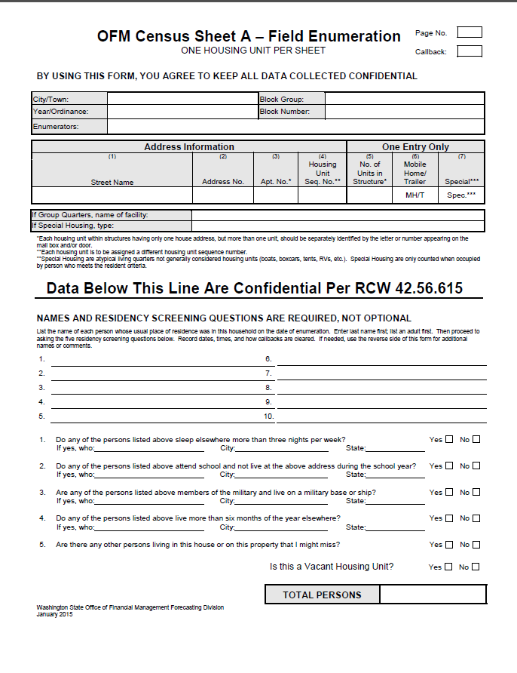
Field Enumeration Sheet
}
}
}
}
Notes:
This is the Field Enumeration Sheet. It is the form used by enumerators to collect the housing and population data for a census.
It can be viewed as having four sections.
[click for animation] In all cases, you need to fill out the first section. The city/town, calendar year/ordinance number, Block number, and enumerator are identified. Every sheet used needs this information
[click for animation] The second section holds the address and structure type information.
If the structure is a group quarters facility, a box to record the facility name is given
If the structure is a special housing unit, a box to record the type of special is given
[click for animation] The third section is where the residents’ names are written, one name per line. If the housing unit is vacant, no names will be written down. Write the word “vacant” in this section.
[click for animation] The fourth section contains the questions that help determine residency status. The respondents often give the names of persons who do not count as a resident. These questions help identify who does or does not qualify as a resident. This is the section where the housing unit is labeled as vacant or not.
Each section will be discussed in detail on the following slides.

Slide 43
Prepare Field Enumeration Sheet
1
Before you walk to the door, fill out the first section of the census form. It is used to record location and enumerator information. Enter the following:
The city/town name. (This may be pre-filled.)
The calendar year or the ordinance number. (This may be pre-filled.)
Initial this form in the enumerator space. Every enumerator who uses the form needs to initial it.
The block group and block number are needed. The block group number may not be known. Ask your supervisor what to enter.
In the upper right corner, enter the page number. Start with “1” for each block.
If this is a return visit, the Callback box should have a “C” in it.
Notes:
This is the first section of the Field Enumeration Sheet. This section must be filled out for each form prior to your interview. It is used to record location and enumerator information. Enter the following information in the appropriate cell:
The name of the city/town
The calendar year, if it is April 1 census, or ordinance number if for an annexation.
The initials of each enumerator that works on this housing unit.
The block group and block number. The block group number can be the supervisor area number or left blank.
In the upper right corner, the page number and the callback box. If this is a return visit, this box should have a “C” entered.

Slide 44
Prepare Field Enumeration Sheet
This next section of the form is used to record information about the housing unit. None of these items should be pre-entered on the form.
When you interview the residents, make sure to verify the address and structure type.
Notes:
The second section is to record information about the housing unit at your next interview. Enter this information before the interview starts as you walk to the unit.
The information needed is: street name, house address, apartment number if applicable, housing unit sequence number, and structure type.
The street name is the street the housing unit’s front door faces. Of course, the house address is the number assigned to the housing unit. The apartment number/letter helps uniquely identify a multi-unit if it does not have a separate house address. Since the housing structure type is needed, if a unit is stick built, enter a number from 1 to 5 in column 5. If the unit is a manufactured home or a special, circle the relevant type in either column 6 or 7.
The housing unit sequence number is assigned to a housing unit sequentially as you do your interviews. Start with sequence number “1” with the first housing unit in each block.
When you interview the residents, make sure to verify the address.

Slide 45
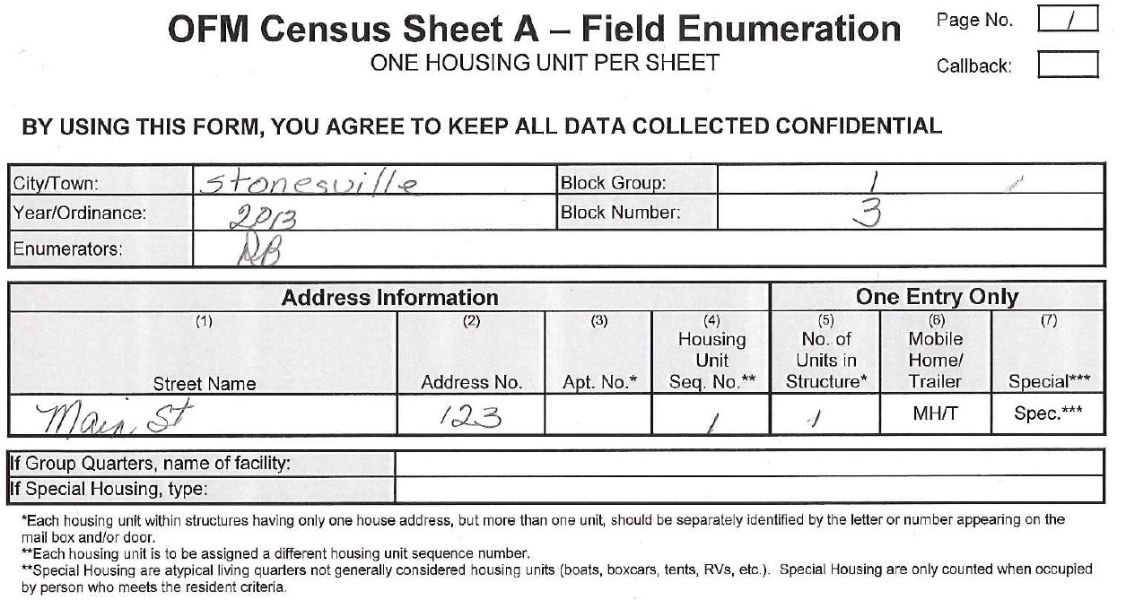
Example of Completed Top Half of the
Field Enumeration Sheet
Notes:
This is an example of the top section filled with appropriate information.

Slide 46
Field Enumeration Sheet Resident Names
Notes:
The third section is for recording residents’ names. Names are required.
The form has room to write ten names. If there are more than ten names to record, just write “over” and continue writing on the back.
Do not erase unless you either wrote a wrong name or misspelled a name
Get complete names, not just first names, or not just a number of persons living in the unit.
If names are refused, record that fact.
Refused names should be recorded as “adult male” “adult female” “child male” “child female”
Try to get names from neighbors.

Slide 47
Interview: Basics
Wear a badge and identify who you are and why you are there
Show mayor’s letter and pledge of confidentiality
Do not go inside the housing unit even if invited
Hand out city promotion material if there is any
Ask for a competent person to gather the initial information
Ask for full names of persons living in this unit
E.g. “I need the names of the persons usually living in this house (or apartment) starting with an adult.”
Write the names in pencil
Erase only to correct names and addresses
Ask about potential other housing units on the property
Ask a business if the building contains units for people to live in permanently
Notes:
When you walk to the house, you should always wear a picture badge. When the resident answers the door, identify who you are, and why you are there. You should hand out any city promotion material and ask for a competent person to answer your questions.
Show the mayor’s letter and pledge of confidentiality. And your ID badge.
Please remember to never go inside the housing unit even if you are invited.
Once the resident agrees to do the interview, you can start by saying something like ”I need the names of the persons living here, starting with an adult.” As mentioned before, full names are needed, not just first names.
You should write the names in pencil, and erase only to correct names and addresses.
Ask about potential other housing units on the property
Ask a business if the building contains units for people to live in permanently

Slide 48
Interview: Basics (continued)
Inquire about neighboring housing units
“Could you tell me who lives next door in case they’re not home?”
If no contact at prior housing unit, ask if they know who lives there.
If no one answers the door, make sure you create an OFM Census Sheet A - Field Enumeration sheet for it.
Note on the back the date and time you were there.
Put a “C” in the “Callback” box in the upper right corner
Leave a door hanger at the time of initial canvass. Note this action in your comments.
Notes:
It is a good practice and is very helpful to ask information about a neighbor during an interview. You can say something like: “ Could you tell me who lives next door in case they’re not home?” This will give you valuable information on how much the neighbor knows. If you lack information concerning the prior house, go ahead and ask.
If no one answers the door, make sure you have created an OFM Census Sheet A - Field Enumeration sheet for it.
Note on the back the date and time you were there.
Put a “C” in the “Callback” box in the upper right corner
Leave a door hanger at the time of initial canvass. Note this action in your comments.
Continue to the next housing unit.

Slide 49
Interview: Screening
Screen the information you have recorded. Ask about persons who may be away for a short time but normally live in this household
Ask if there is a new baby still in the hospital.
Next, using the first four screening questions at the bottom of the form to help determine residency status.
If needed, void wrong entries. Do not erase.
Void if person mistakenly gives a wrong name
Void if person listed is not a resident. But do not void in front of respondent. Respondent tends to object when a family member is eliminated from the census.
The fifth screening question is designed to find hidden housing units that may be on the property. A relative or friend may be staying in an RV or onsite apartment. The person(s) in this unit may or may not have been included with the main family. A separate form is needed for an additional housing unit.
Notes:
Screen the information you have recorded. Ask about persons who may be away for a short time but normally live in this household
Ask if there is a new baby still in the hospital.
Next, use the first four screening questions at the bottom of the form to help determine residency status.
If needed, void wrong entries. Do not erase. To void, draw a line through the name and write “void” beside the name
Void if person mistakenly gives a wrong name
Void if person listed is not a resident. But do not void in front of respondent. Respondent tends to object when a family member is eliminated from the census. Write the reason next to name (e.g., “at college”). Do the “void” on your way to the next housing unit
The fifth screening question is designed to find hidden housing units that may be on the property. A relative or friend may be staying in an RV or onsite apartment. The person(s) in this unit may or may not have been included with the main family. A separate Field Enumeration Sheet is needed for an additional housing unit.

Slide 50
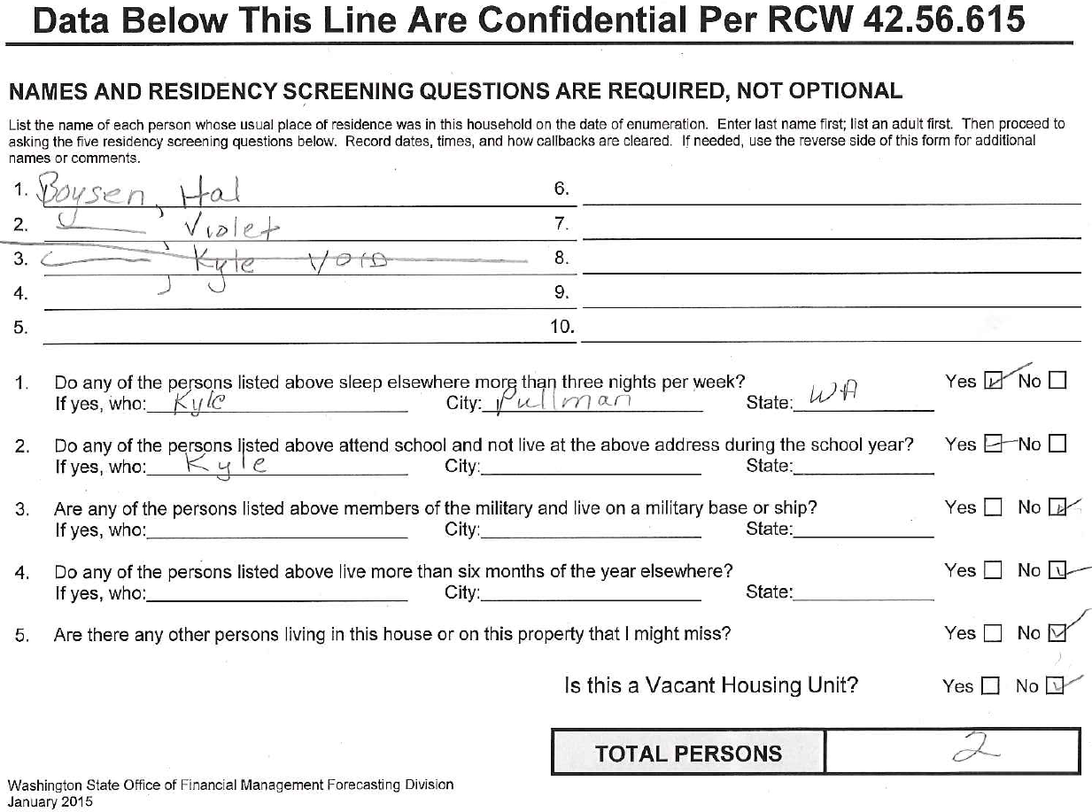
Interview: Screening Example
Notes:
This example demonstrates the result of a complete interview of a household. The enumerator originally recorded three persons living in this household. During screening he found out that Kyle is a college student who lives where he is attending college. So the enumerator wrote void next to Kyle’s name and counted two persons as eligible residents in this household.

Slide 51
Callbacks
If nobody is home, you need to
Complete top of Field Enumeration Sheet, put a “C” in the Callback box in the upper right corner of the form.
Record date and time on the back of the sheet
Put your initials at the top in the appropriate box
Get information from neighbors
Names of residents, places of employment, when family is home, etc.
If you can verify the same information from two neighbors, you do not need to try to contact residents again. Just complete the form with the information provided by the neighbors. Clear the callback, by making a diagonal cross through the letter “C” you entered in the box in the upper right corner of the form
Notes:
When no one is home to answer the door, you still need to complete the top section of the Field Enumeration Sheet, put a “C” in the callback box and record the date and time you visit the housing unit. Do the same if someone answers the door but absolutely refuses any information. Be sure to write a note about this situation.
If you can verify the same information from two neighbors, you do not need to try to contact residents again. Just complete the form with the information provided by the neighbors, and document it. Then clear the callback, by making a diagonal cross through the letter “C” you entered in the box in the upper right corner of the form.

Slide 52
Vacant Housing Unit
You still need to complete a Field Enumeration Sheet for a vacant housing unit. Then in the names section just write “vacant.”
If it is a new construction that qualifies for inclusion in the census, write “VNC.”
No need for a Field Enumeration Sheet if the structure in front of you is a dilapidated house or is an unoccupied special like an RV or tent.
Notes:
You are at the front door of a housing unit. You are able to determine that it is vacant.
You still need to complete a Field Enumeration Sheet for the unit. Complete the first and second sections. In the middle section instead of names, just write “vacant.” If it is a new construction that qualifies for inclusion in the census, write “VNC.”
If no housing units are found in a block, a Field Enumeration Sheet needs to be completed for the block. Complete the top sections of the form and write “empty block” in the middle section
No need for a Field Enumeration Sheet if the structure is not considered a housing unit such as dilapidated house, or special like RV or tent.

Slide 53
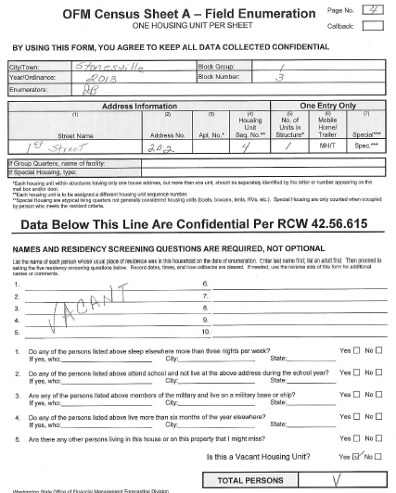
Field Enumeration Sheet: Vacant Housing
Notes:
Here is a completed sample Field Enumeration Sheet for a vacant house. The top sections are filled in normally. The middle section does not have any names. The word “Vacant” is written in this section on an angle. The angle helps assure that population will not be counted accidentally.
There is no need to answer the questions since no one lives here. Check “yes” that this unit is vacant down at the bottom. In the “Total Persons” box, enter a “V.”

Slide 54
Enumeration Procedure: Group Quarters
Contact your supervisor before attempting to enumerate any group quarters in your area. He/she may already have contacted it.
Contact the manager of the facility
Record the manager’s name and contact information.
Explain the need for a census
Explain the residence requirements
Request a list of resident’s names.
Work with the manager to eliminate the names of people who do not meet residence requirements like people living in the facility for rehabilitation.
Ask the manager if any staff live on site.
Enumerate resident staff on a separate sheet(s) if they meet resident criteria.
Staff living quarters are not group quarters. Be sure to assign structure type and a housing unit sequence number.
If there is no list, obtain the names of residents from the manager, but do not interview the residents.
Do not assign a housing unit sequence number to the facility.
Notes:
Contact your supervisor before attempting to enumerate any group quarters in your area. He/she may already have contacted it.
Contact the manager of the facility
Record the manager’s name and contact information.
Explain the need for a census
Explain the residence requirements
Request a list of resident’s names.
Work with the manager to eliminate the names of people who do not meet residence requirements like people living in the facility for rehabilitation.
Ask the manager if any staff live on site.
Enumerate resident staff on a separate sheet(s) if they meet resident criteria.
Staff living quarters are not group quarters. Be sure to assign structure type and a housing unit sequence number.
If there is no list, obtain the names of residents from the manager, but do not interview the residents.
Do not assign a housing unit sequence number to the facility.

Slide 55
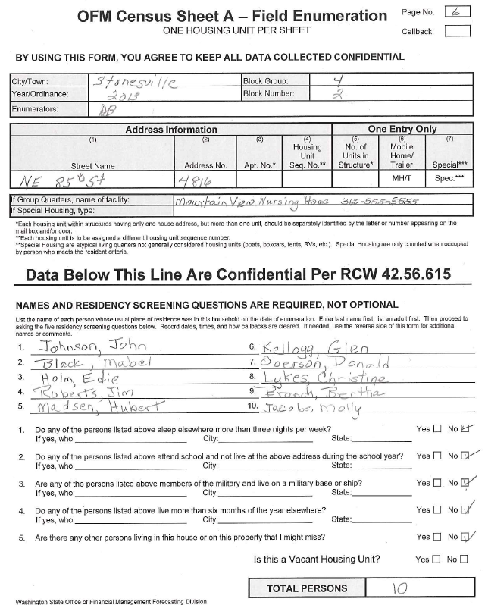
Field Enumeration Sheet: Group Quarters
Notes:
This is an example of a form completed for a GQ facility. Look at the sample. There is no housing sequence number or structure type indicated.
In the area below the address information, the name and telephone number of the facility is written. You either write the resident names on this form or staple a list to it. Questions 1-4 are answered.
At the bottom of the form, the number of people resident in the facility is written in the “Total Persons” box. Ignore the question about a vacant house.

Slide 56
Enumeration Procedure: Safe Houses, Youth Homes
Enumerate Safe Houses and Youth Homes by contacting the staff or counselor
For safe houses, verify numbers of persons who do not have any place else to live. Document as refusals.
Do not identify it as safe house on the form
For a youth home, verify numbers of persons that are there long-term or expected to be
Do not list names - State law protects residents’ confidentiality. List as refusal.
Do not identify this unit as a youth home on the form
If staff and counselor live onsite, it is OK to obtain their names. And their living quarters should be counted as a housing unit.
Notes:
Enumerate Safe House and Youth Homes by contacting the staff or counselor
For safe houses, verify numbers of persons who do not have any place else to live. Document as refusals.
Do not identify it as safe house on the form
For a youth home, verify numbers of persons that are there long-term or expected to be
Do not list names - State law protects residents’ confidentiality. List as refusal.
Do not identify this unit as a youth home on the form
If staff and counselor live onsite, it is OK to obtain their names. And their living quarters should be counted as a housing unit.

Slide 57
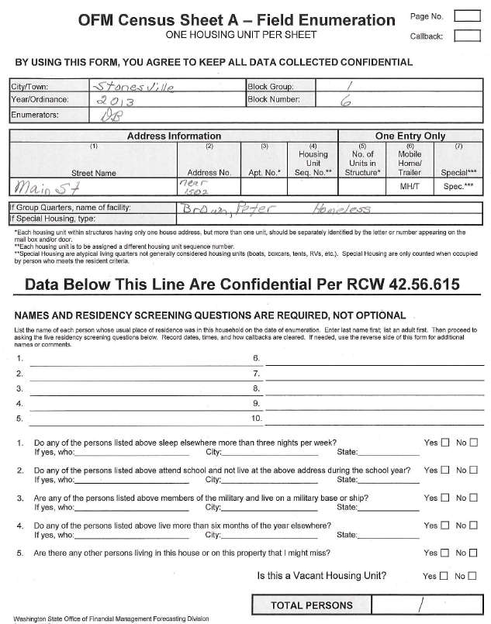
Field Enumeration Procedure: Homeless
Notes:
The last situation you may encounter is a homeless person. If you encounter homeless people who do not live in any shelter, list street location where you found him/her as the home. Write the person’s name and “homeless” on GQ “Name of Facility” line. Do not write anything in the middle section.

Slide 58
Supplies Needed in the Field
Cell phone
Enough Field Enumeration Sheets to last for a day
Enumeration map of assigned area (s)
Enumerator manual
3-ring binder
No. 2 pencils and pencil pouch
Map of your assigned area
Extra paper to note questions, items of interest
City promotion materials if any
Door hanger for callback
Notes:
58
Before you go into the field each day, make sure you have your basic supplies with you. These include, but are not limited to:
Cell phone
Blank field enumeration sheets. You need to have enough to last for the day.
A three ring binder to hold your forms. It also provides a sturdy writing surface.
No. 2 pencils and a pencil pouch. No ink pens are to be used. In damp weather, anything other than a #2 pencil tends to tear the paper.
A copy of Enumerator Manual.
Extra paper to make notes, explanations, and/or questions for your supervisor.
A map of your assigned area.
City promotion materials if any
Door hanger for callback
Anything else your supervisor deems useful/necessary.

Slide 59
Problem Situations
If you encounter people who appear to be resistant and angry, politely excuse yourself.
Report these cases to your supervisor.
Supervisor should attempt to enumerate this unit.
Try to get information from neighbors.
Names are preferred, but descriptions such as: “adult male, female child, etc.” are acceptable as long as the number of instances are few in number overall in the census.
Document situation – use the back of the form as needed.
When you see “No Trespassing” signs, do not walk to the door. Create a census form for the housing unit. Write comments describing the situation. Report to your supervisor.
Feel free to give our phone number to people who would like to verify the census: 360-902-0599
Notes:
If you encounter people who appear to be resistant and angry, politely excuse yourself.
Report these cases to your supervisor.
Supervisor should attempt to enumerate this unit.
Try to get information from neighbors.
Names are preferred, but descriptions such as: “adult male, female child, etc.” are acceptable.
Document situation – use the back of the form if needed.
When you see “No Trespassing” signs, do not walk to the door. Report to your supervisor.
Feel free to give our phone number to people who would like to verify the census: 360-902-0599

Slide 60
Language Barrier
If you come across people that speak a different language than you:
Try and identify the language
If you have materials in your binder prepared in that language, show respondent those materials.
If the respondent is not able to answer the census at that time, flag the enumeration form for that household for the supervisor/ administrator to handle later.
Be sure to document the situation.
Notes:
If you come across people that speaks a different language than you
Try and identify the language
If you have materials in your binder prepared in that language, show respondent those materials.
If the respondent is not able to answer the census at that time, flag census form for that household for the supervisor/ administrator to handle later.
Be sure to document the situation.

Slide 61
Frequently Asked Questions
Notes:
Sometimes, residents will ask questions about the census. Here we list a few commonly asked questions.

Slide 62
Frequently Asked Questions
Who receives this information? Is it protected?
This information is confidential and is protected by state law.
The enumerator is not allowed to give the census sheets to anyone but his/her supervisor
The city is not allowed to make copies of any field enumeration sheet except blank forms
After tallying, all sheets are sent to the state. The state destroys the paperwork after verifying numbers
Reassure resident by showing letter signed by the mayor and the enumerator that shows agreement to keep information confidential
Notes:
Who receives this information? Is it protected?
The first most asked question is about confidentiality. Census data are protected by state law. No one is allowed to give the field enumeration sheets to anyone except supervisors. None of the paperwork is kept or copied by the city. It all is sent in to the state who destroys confidential papers when finished with them.
You can also show your mayor paragraph and signed confidentiality statement to the residents to reassure them.

Slide 63
Frequently Asked Questions
What’s the purpose of this census?
The population number will be used to allocate state government funds for public services.
The population numbers will be used in health, transportation and public school planning
Notes:
What is the purpose of this census?
The purpose of this census is to collect as accurate a population count as possible. There are monies that are disbursed to cities and towns based upon population.
There are approximately 200 RCWs that use population numbers in one way or another for funding and other purposes.

Slide 64
Frequently Asked Questions
Why are the full names required?
The names are used to verify that people are not missed or double counted in the census.
Names are used for supervisor field checking
Names are also used for OFM office and field checking.
If census is tabulated with > 5% no-names, enumerators may be required to re-canvass the area
Notes:
Why are the full names required?
Names are used to verify that persons are only counted once. Also, they help to add any missed persons and eliminate double counts.
The names are also used to evaluate enumerator performance. Both census supervisor and OFM can randomly check census results.
If there are more than 5% no names tabulated, enumerators may have to re-canvass an area.

Slide 65
End of this Training Session
Start your enumeration of your assigned area per your supervisor’s instructions.
Be professional.
If you have questions, ask your supervisor.
Notes:
This is the end of the enumerator training presentation. If you have questions, ask your supervisor.

